Slide 1
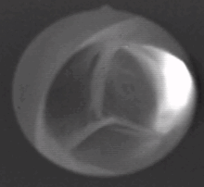
Aortic Valve: Mechanical Role
Valve Motion:
Highly Dynamic, valve opens and closes ~ 40 million times/year in response to flow!
Cyclic mechanical stress and strain
Characteristics:
Strength & durability
Geometry and structure essential for proper valve function.
Pig aortic valve
From https://en.wikipedia.org/wiki/Aortic_valve

Slide 2
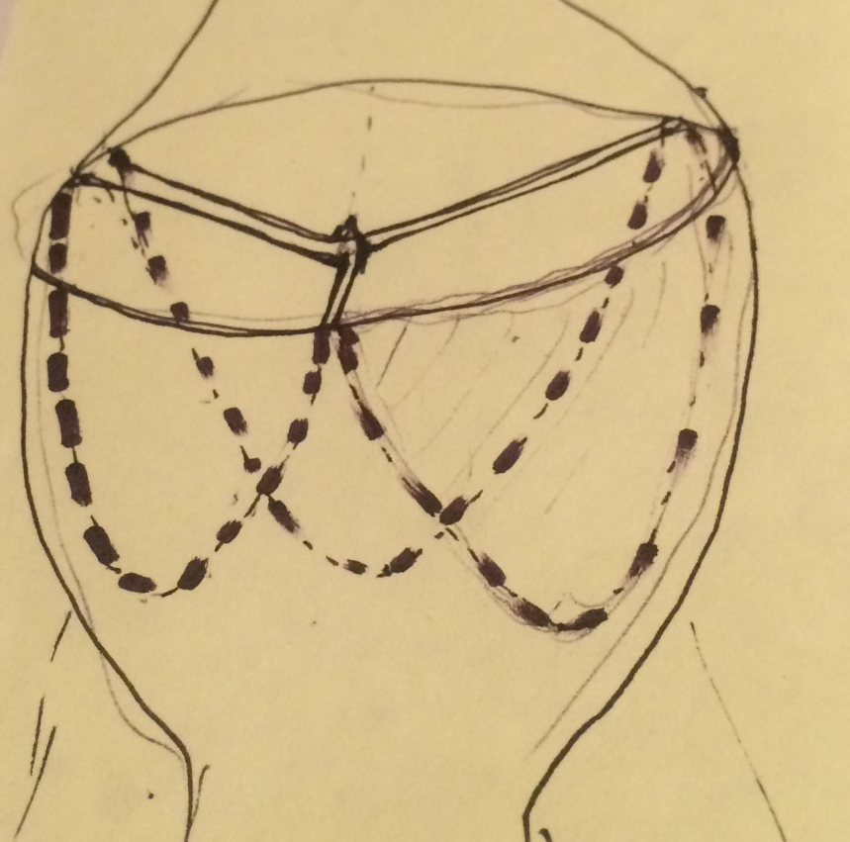
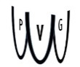
Notes:
Hinge Points
Engineering lingo “Angle of Repose” as the leaflets “lean” into each other

Slide 3
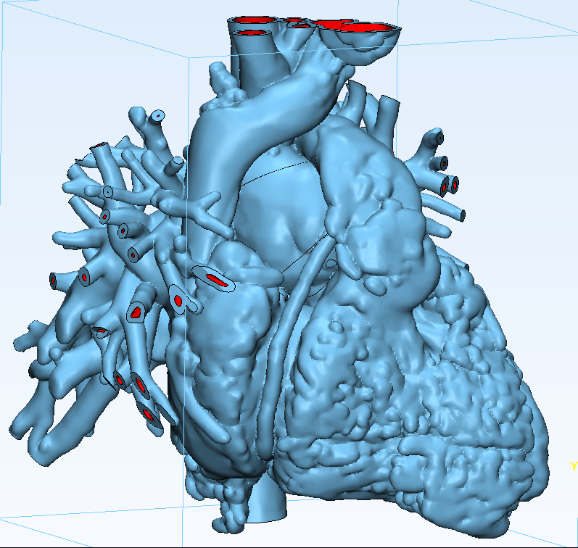

Slide 4
Limits of valve surface area
Lower limit
Competent (diastole): area of coaptation
Not stenotic (systole): orifice area
Upper limit
Coronary blood flow: “caught between a rock and
a hard place”
Notes:
Leaflets lean against each other as the valve closes

Slide 5
Aortic root diameter is unaffected by the severity of aortic stenosis (n = 827)
Notes:
827 patients from Kinetics database (OHSU Echo Lab, 2013-16). Searched all patients who had (1) Ao Root Diameter (2DE via ASE guidelines, BSA-adjusted), (2) continuous wave doppler velocities. AS is defined by Doppler velocity > 2.0 m/s.
Study
Cntrls: Normal tricuspid, competent (no insufficiency) and no stenosis by definition
Abn: Bicuspid, tricuspid, stenosis, non stenosis, incompetant, etc.
A new hope, us

Slide 6
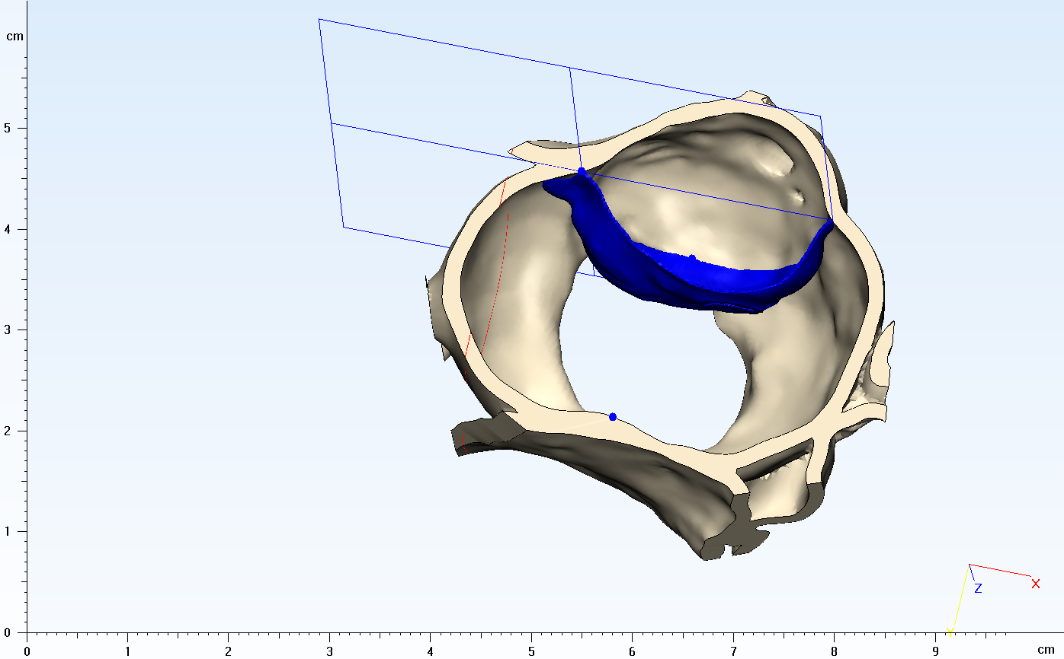
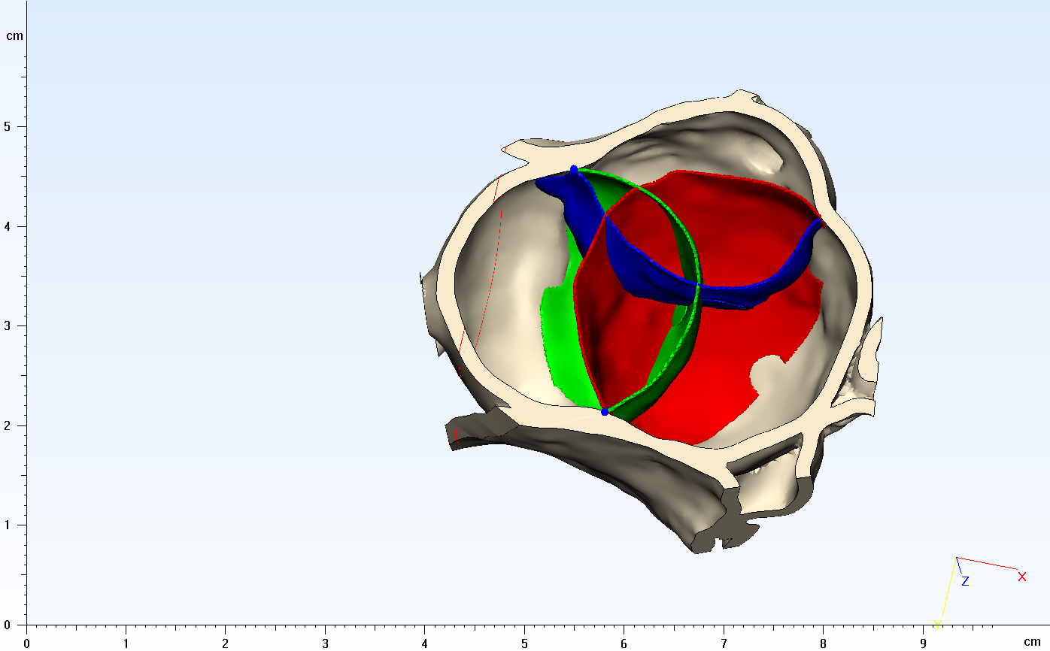
Methods
4: Create valve based on mirroring of aortic sinus geometry

Slide 7
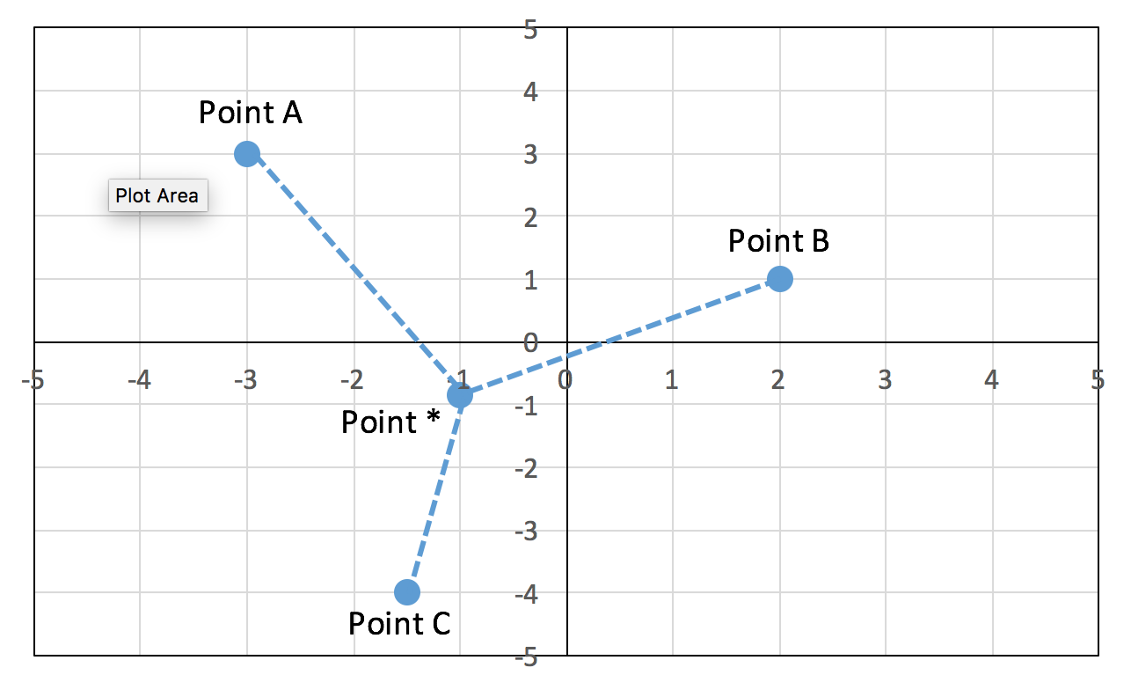
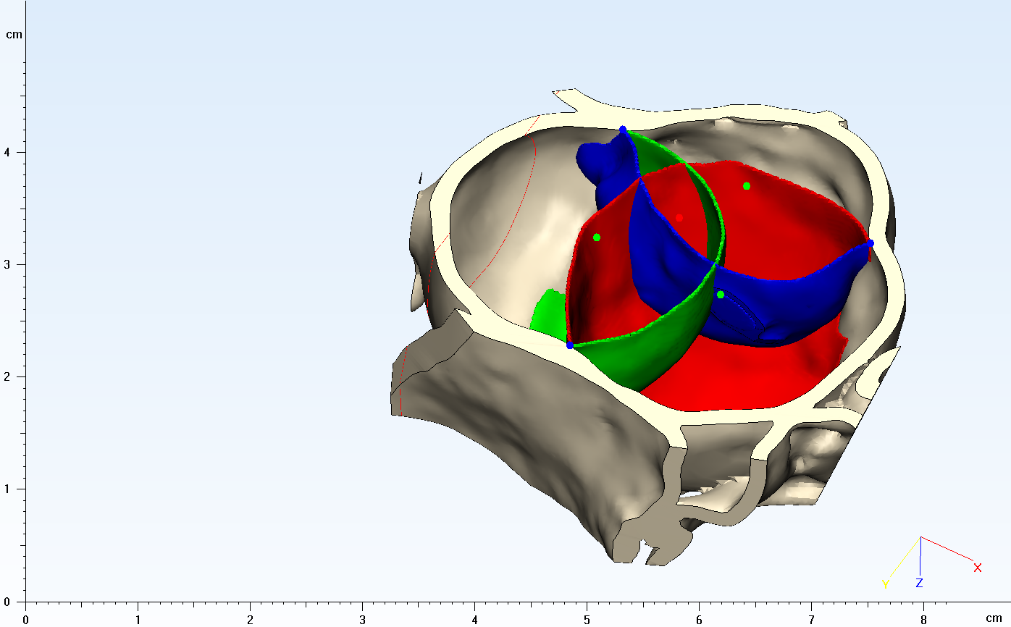
Methods
5: Calculate coaptation area/overlap volumes, orifice size
Notes:
Centroid. Put in picture of normal valve to define our nomenclature.

